Slide 1


Team A
Cameron Dawson, Paula Faidley, Matthew Davidson, Caleb Ishola, Dylan Colburn, Hiren Patel, Lauren Koopa

Slide 2


Trello
https://trello.com/b/IXdINZ0J/scavengerus

Slide 3
Login and Sign-Up Page
The Sign-up page gets the user information for registration.
After clicking sign up, user gets redirected to a page that informs them about the next steps.
After the user clicks the log in button, user gets redirected to the tasks page.

Slide 4
Bootstrap
Bootstrap was fully implemented
All CSS is showing
Navbars on every page
Links on every page working
JavaScript Implemented

Slide 5
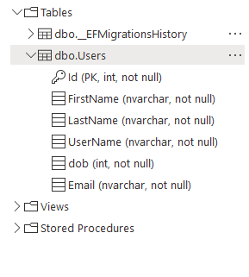
Database
DNF kind of...
Database was created and connected to project via connection strings. A table was created (as shown to the left) but was not populated as we ran out of time. Entities exist but are not utilized.

Slide 6
Completed
QR Scanner
GitHub Integration
PID Update
Trello Updated
Server Deployed and Working
Database Created / Migration Made
Entities for Database Made
Bootstrap implemented
UML / Network Diagram
Log In / Sign Up Pages

Slide 7
Next Steps
Complete Integration and Population of Database
Email and SMS Integration
Log In Function integrated
Scavenger Hunts need Implementation

Slide 8
Time Spent This Sprint
80 hrs

Slide 9

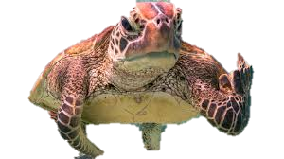
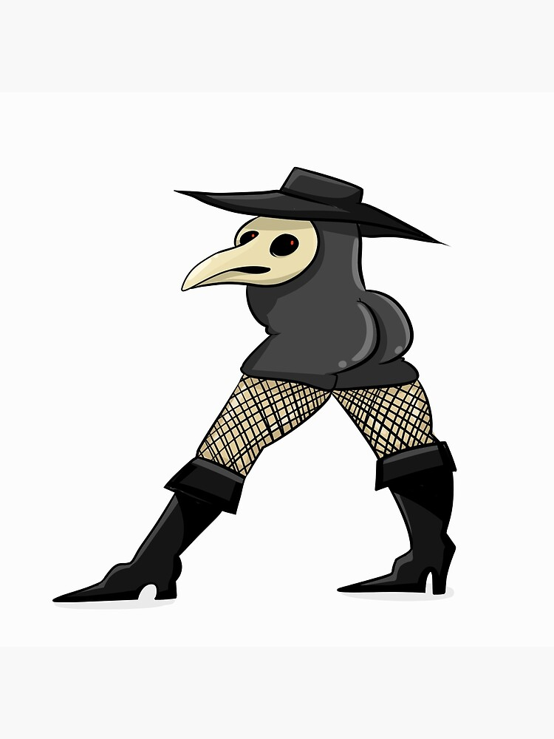
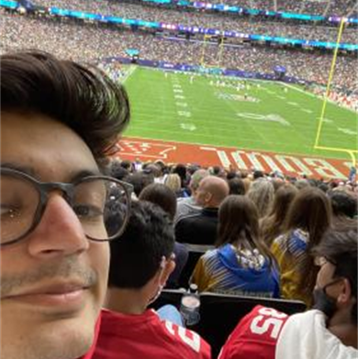
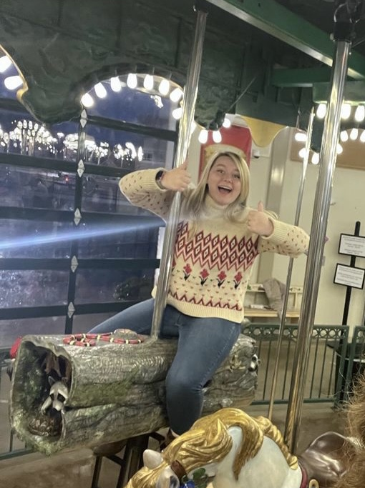
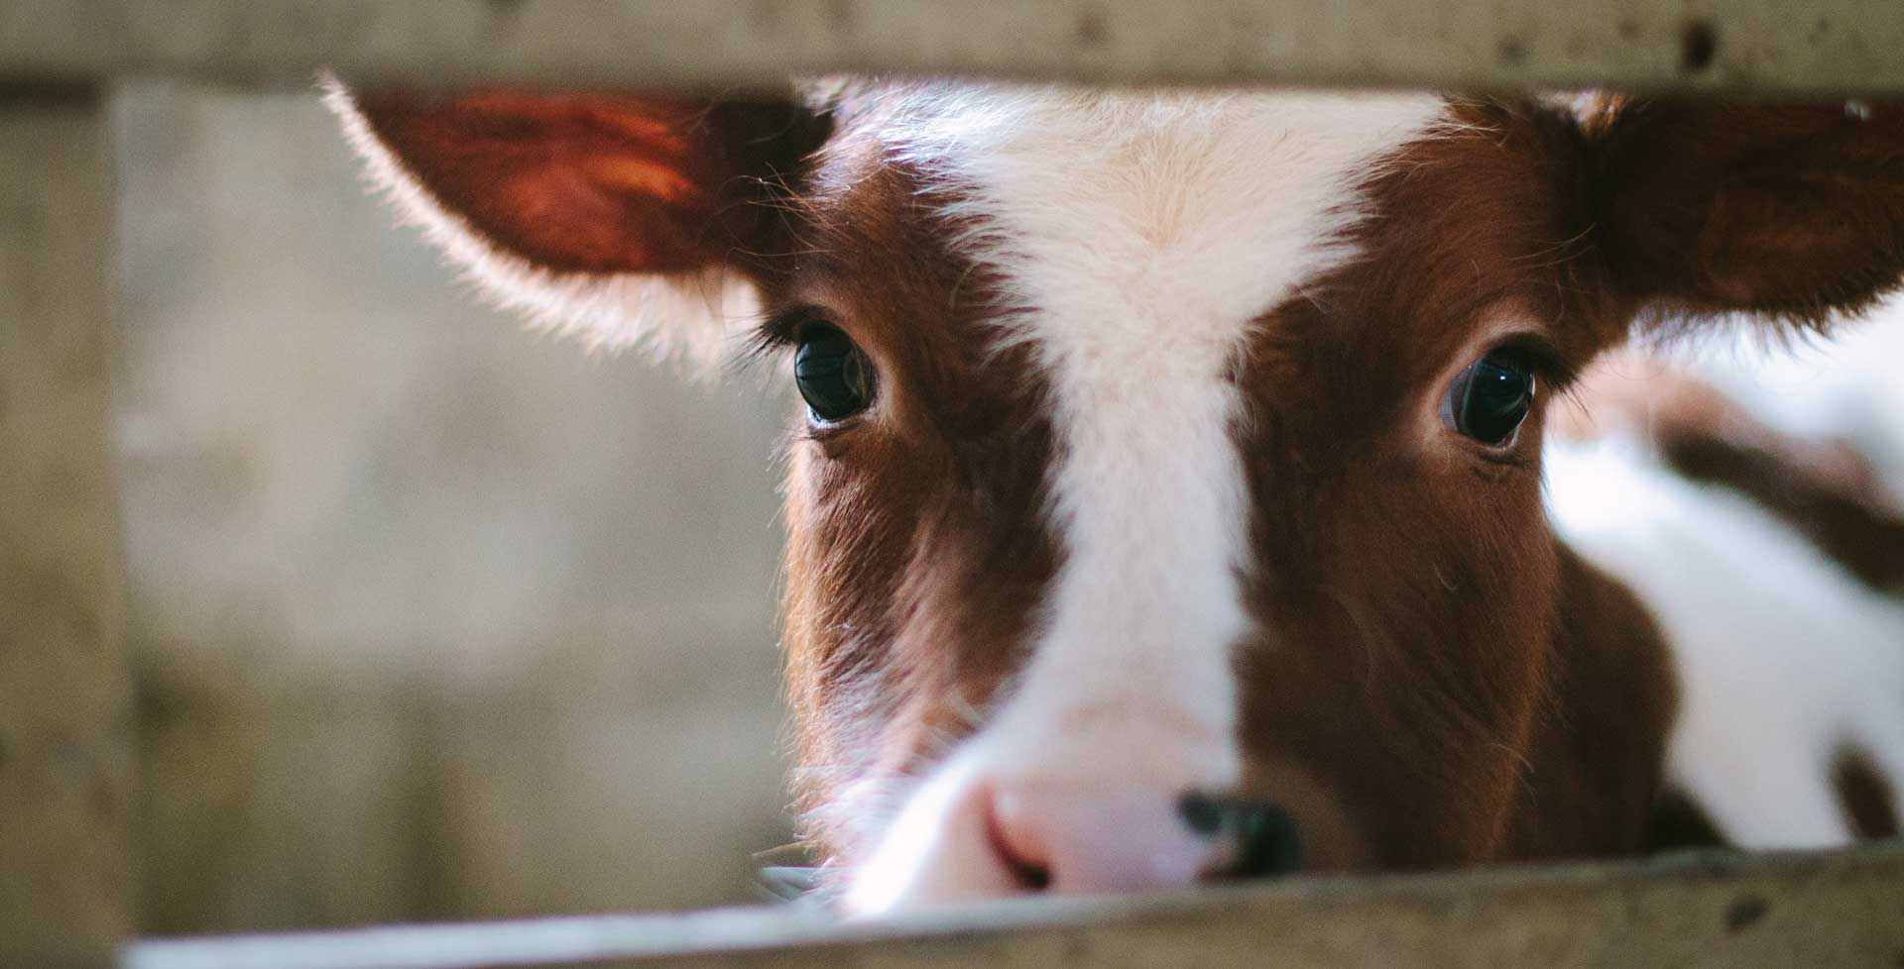
SPECIAL THANKS…

